Slide 1




(21CC505PC) SOFTWARE ENGINEERING LAB
UPPAL CAMPUS
NARAYANGUDA
IBRAHIMPATNAM
LAB EXERCISE - 5
CASE TOOL
TOPIC -1
INSTALLATION OF ECLIPSE, MAVEN, JDK, TOMCAT,CONFIGURING TOMCAT TO ECLIPSE
BY
B MADHURIKA
Assistant Professor
CSE

Slide 2

SOFTWARE ENGINEERING LAB
(21CC505PC)
BY
MADHURIKA BUDARAJU
ASSISTANT PROFESSOR
CSE
KMIT

Slide 3
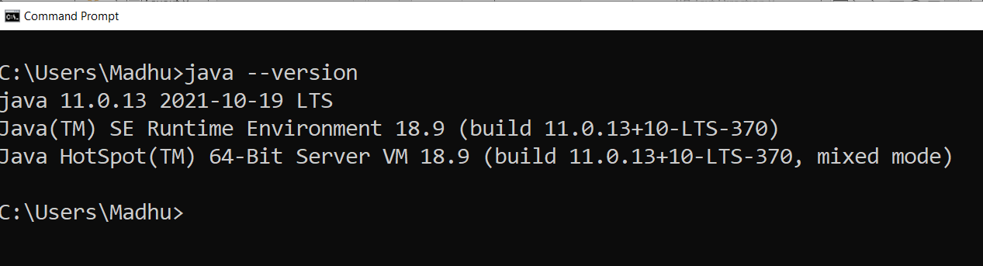
Install JDK 11 / 17 / 21 versions
Set the class path
Check for the version

Slide 4
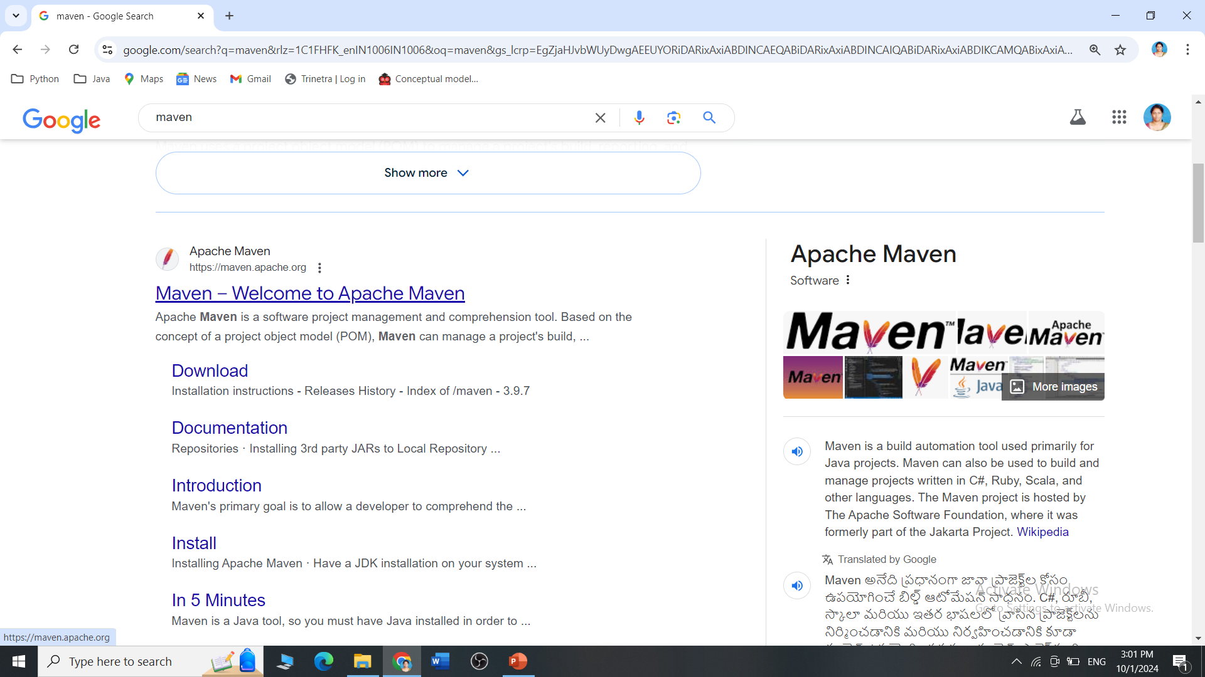
Maven installation
Step 1: Check whether maven is present in your system or not
Step 2: Go to Google type download maven and click on download Apache maven

Slide 5
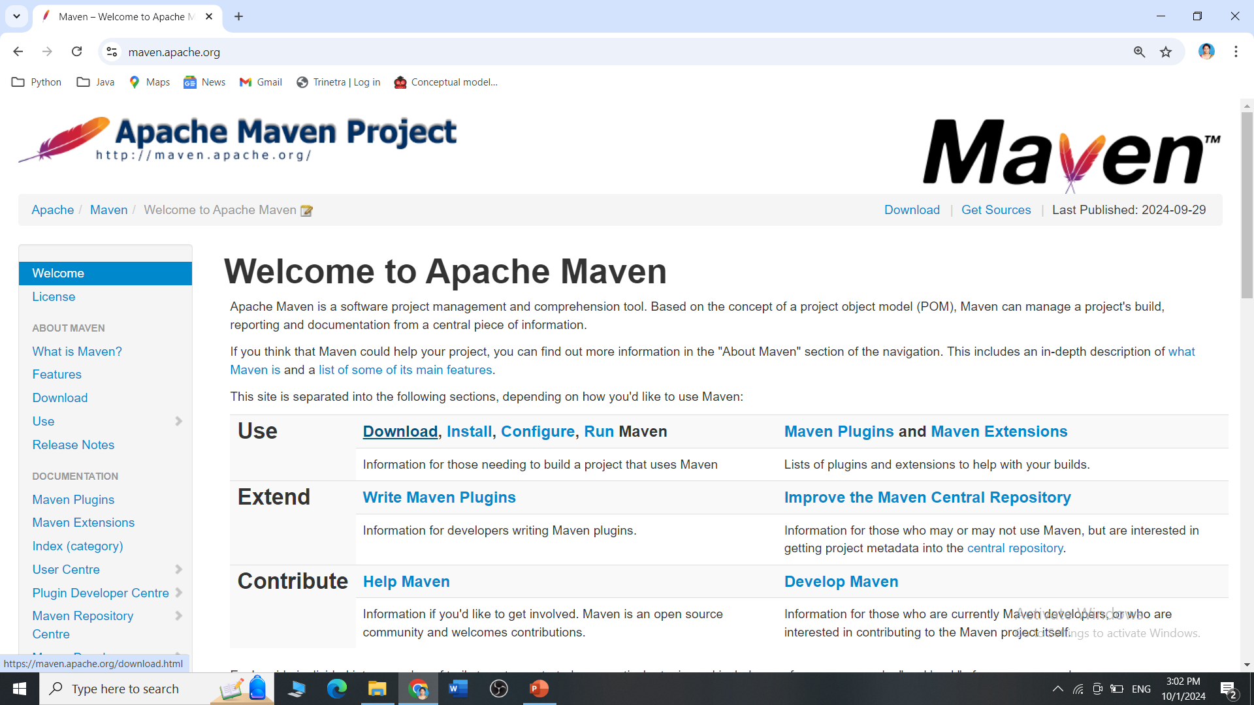
Maven installation
Step 3: Open the Maven Official Webpage

Slide 6
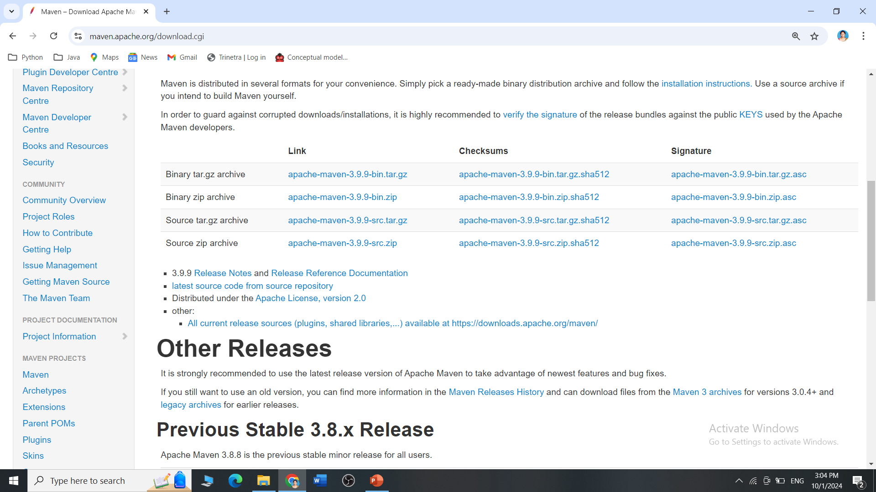
Maven installation
Step 4: Scroll down to go to downloading links

Slide 7
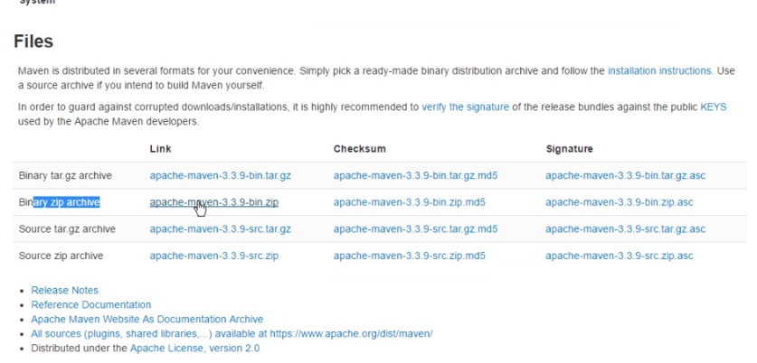
Step 3: click on apache-maven-3.3.9-bin zip

Slide 8
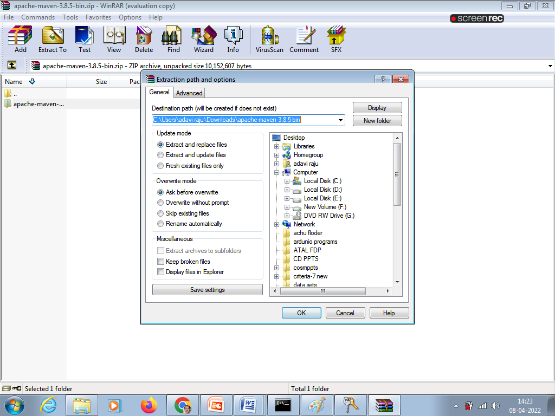
Step 4: extract zip file

Slide 9
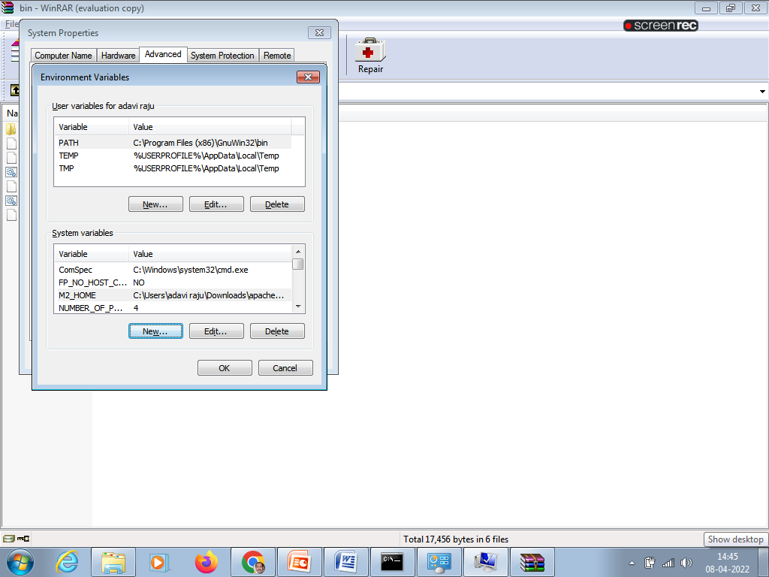
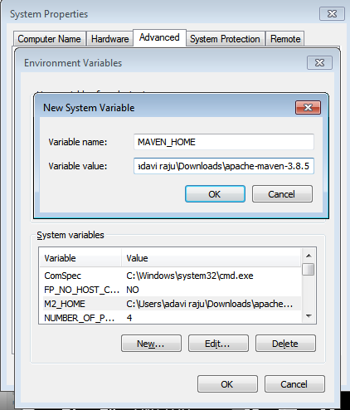
Step 5: set environment variables

Slide 10
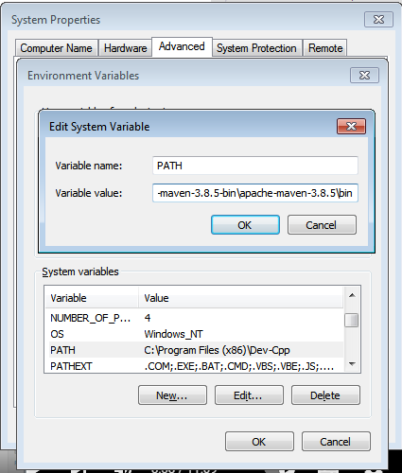
Edit path

Slide 11
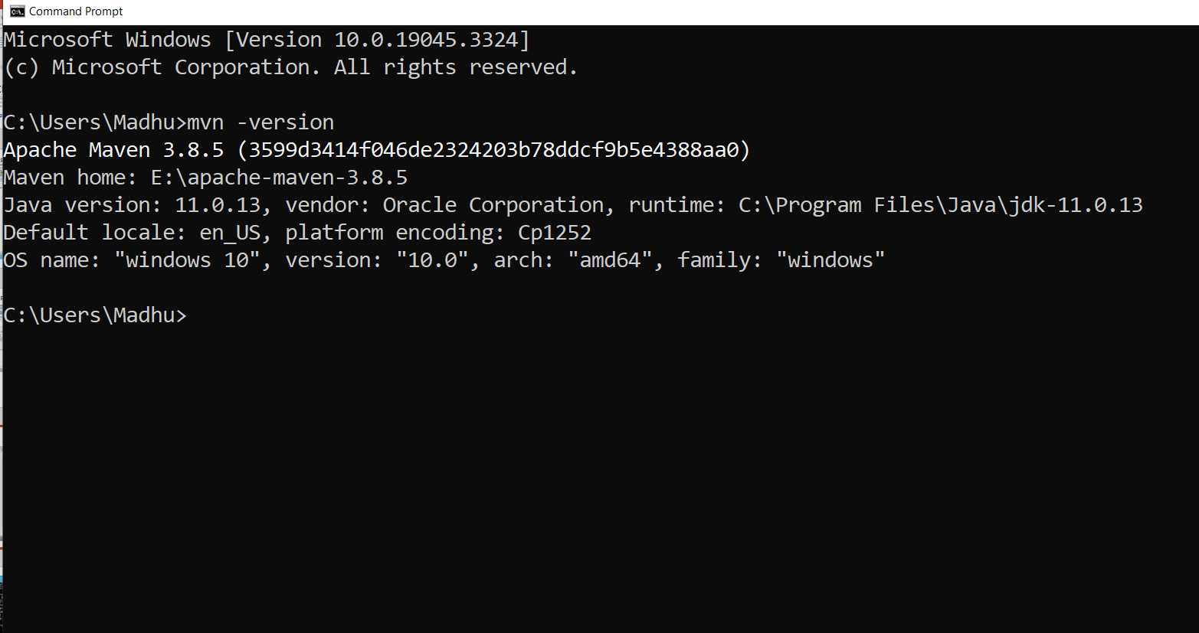

Slide 12
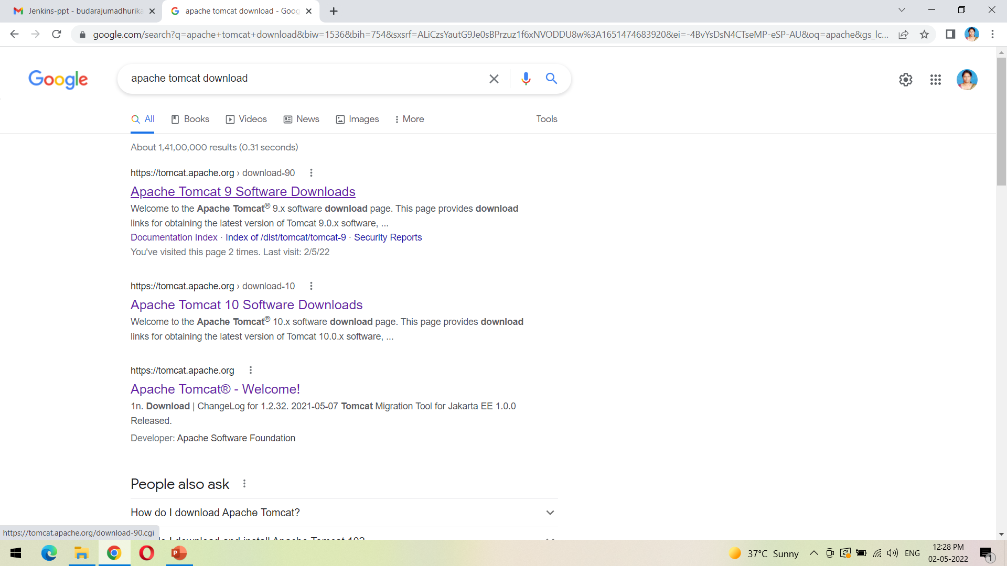
Download the tomcat from the first link as shown

Slide 13
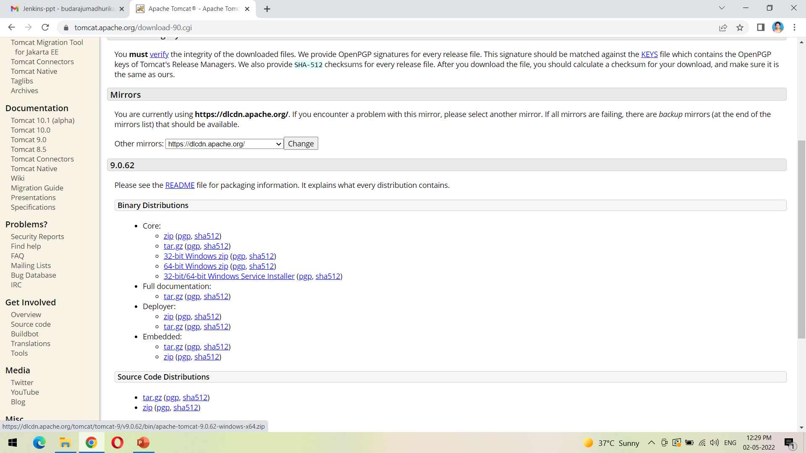
Click on the following link 64-bit windows zip to download the zip file

Slide 14
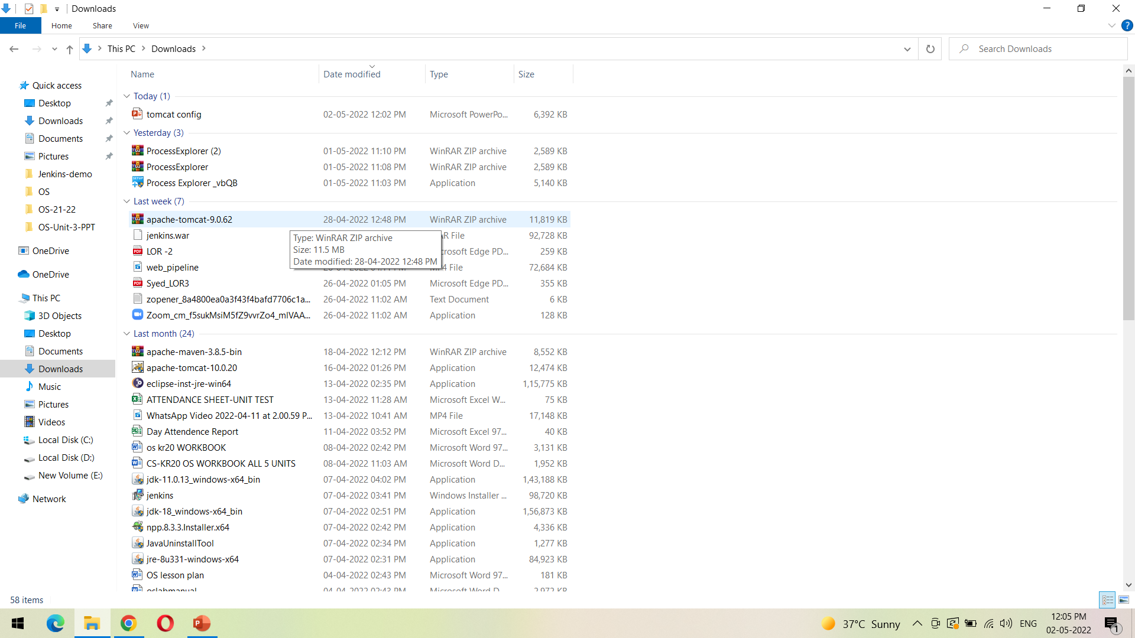
We can view the downloaded file from Downloads folder as shown

Slide 15
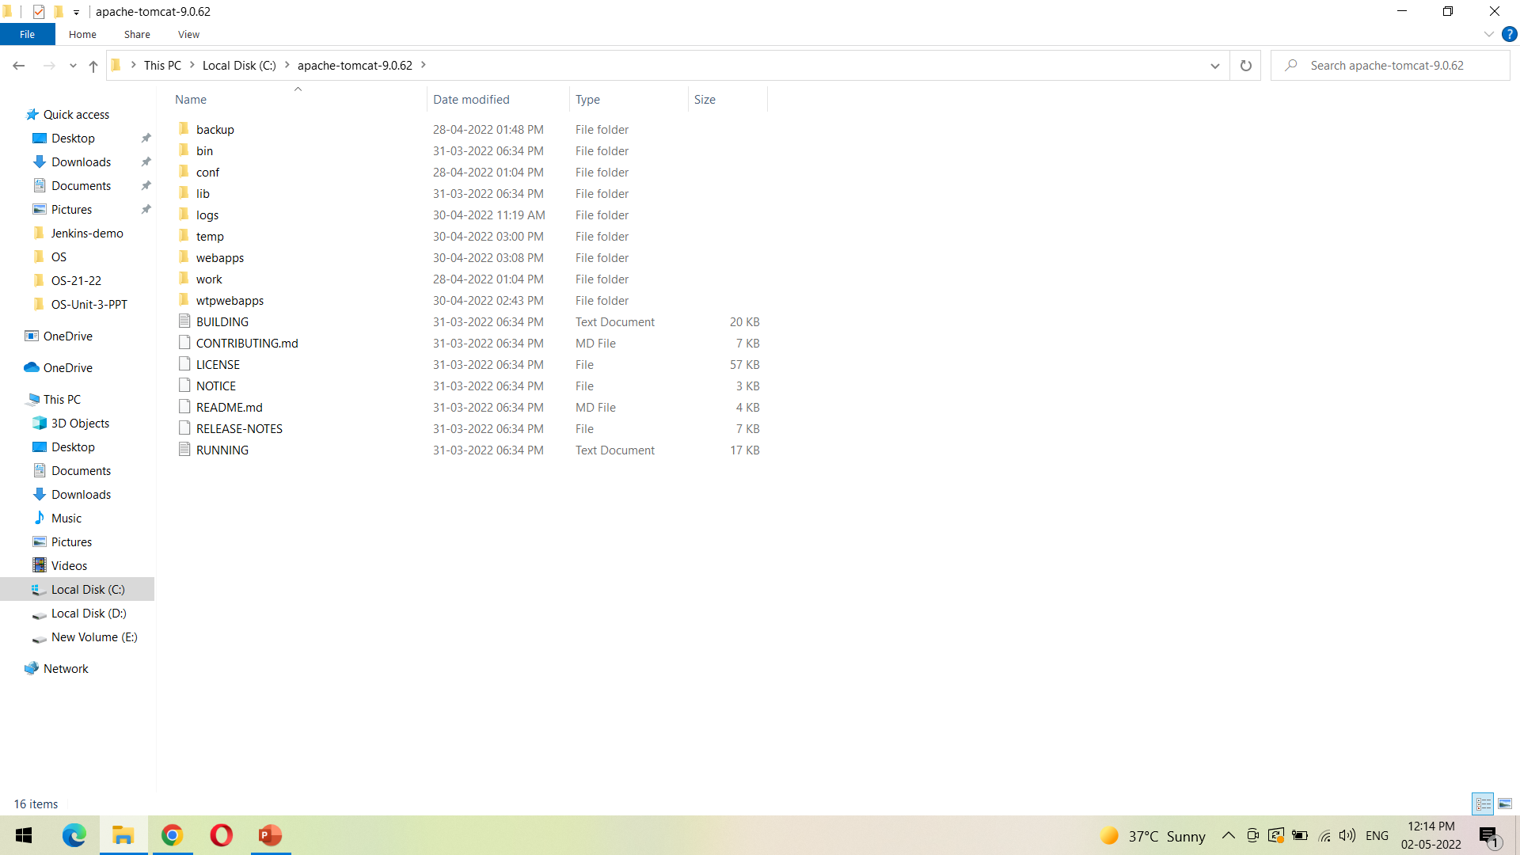
Unzip the downloaded file into the path shown

Slide 16
ECLIPSE UPDATES Installation
Before configuring Tomcat to Eclipse

Slide 17
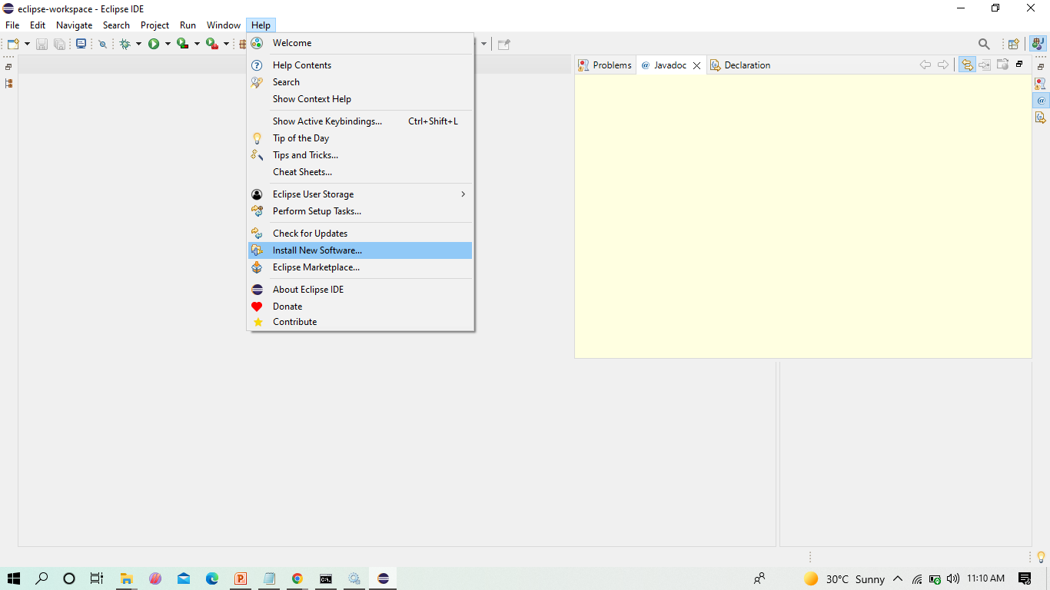
INSTALL UPDATES into eclipse

Slide 18
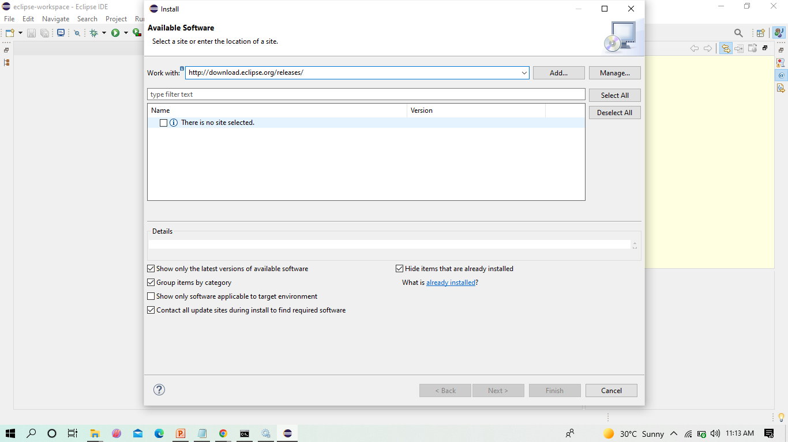
Before installing server into eclipse, we need to add Java EE to the eclipse IDE

Slide 19
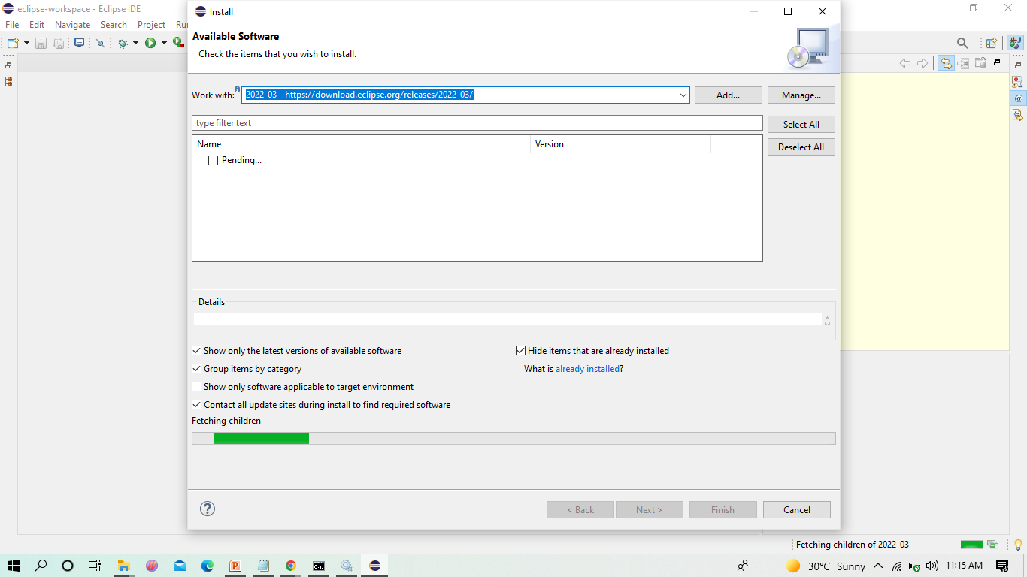
Click on the drop down menu in Work with and select the following from the list

Slide 20
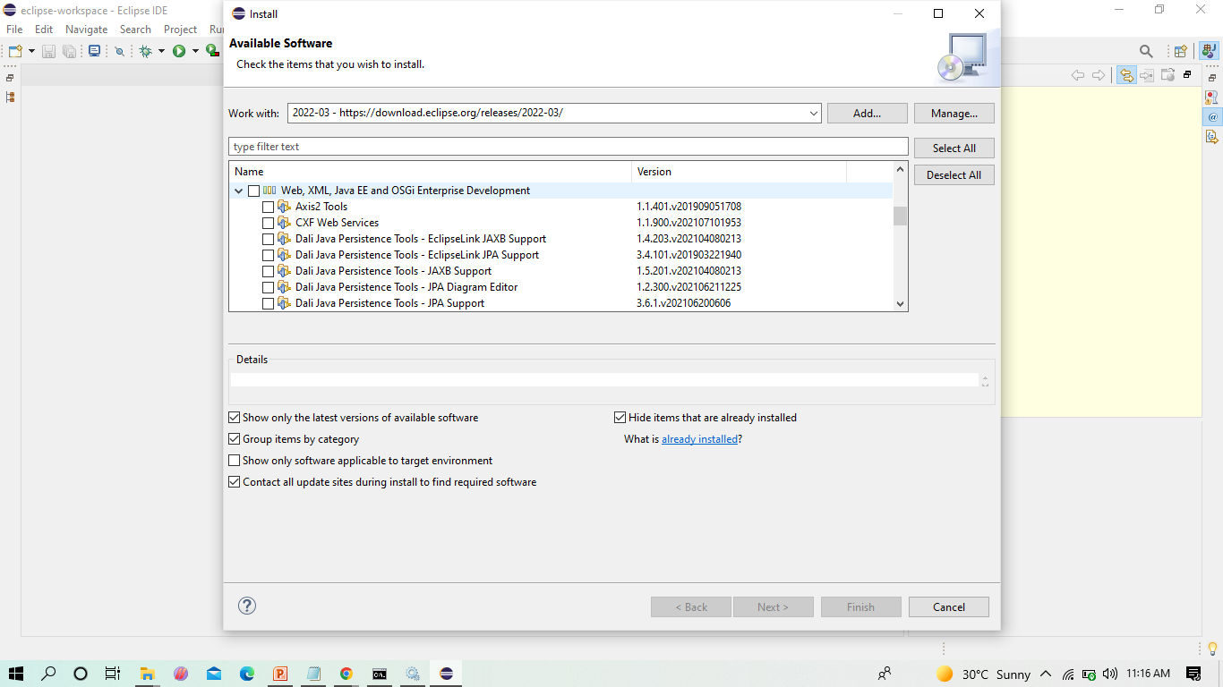
Check the Web,XML,JAVA EE box to install the latest software into eclipse in order to execute the dynamic web projects, maven web projects. Etc.

Slide 21
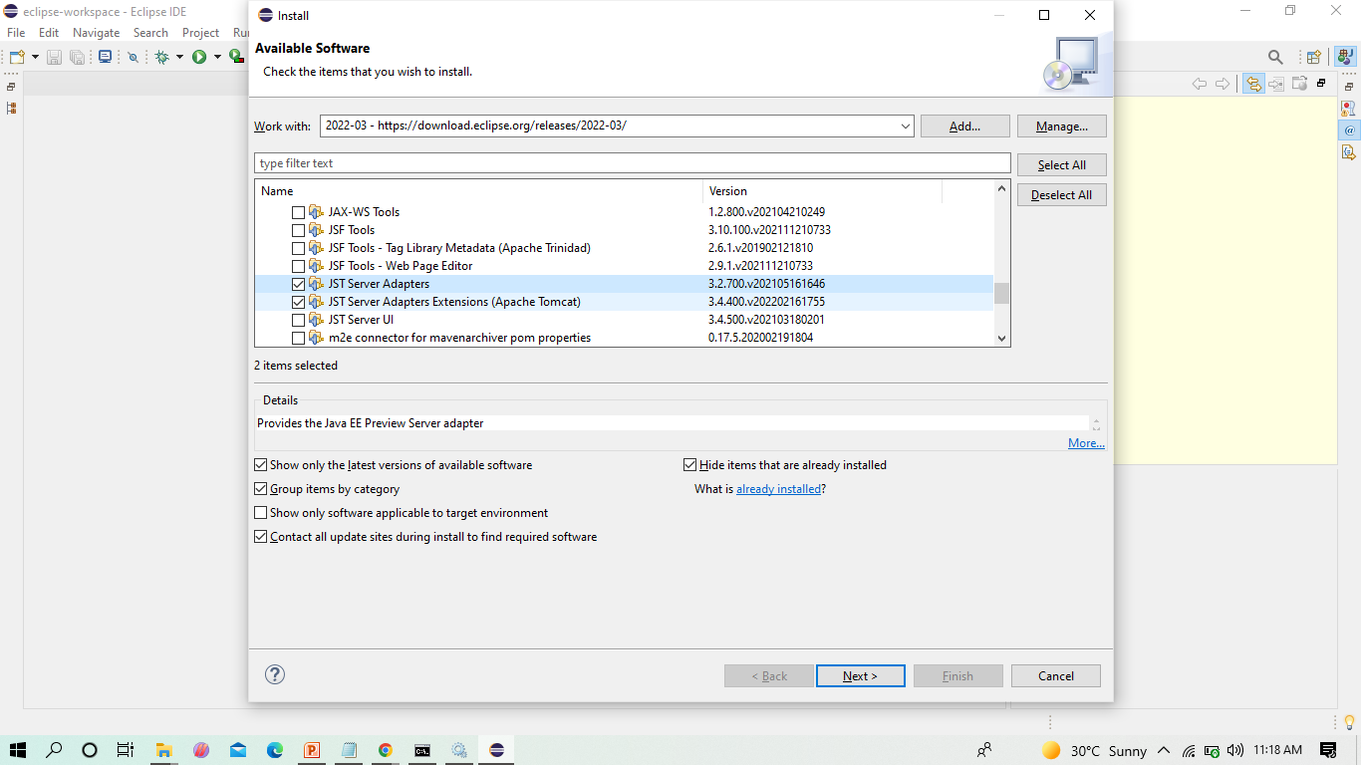
Since we develop only Maven web project in DevOps, we can only check the shown two and click on next

Slide 22
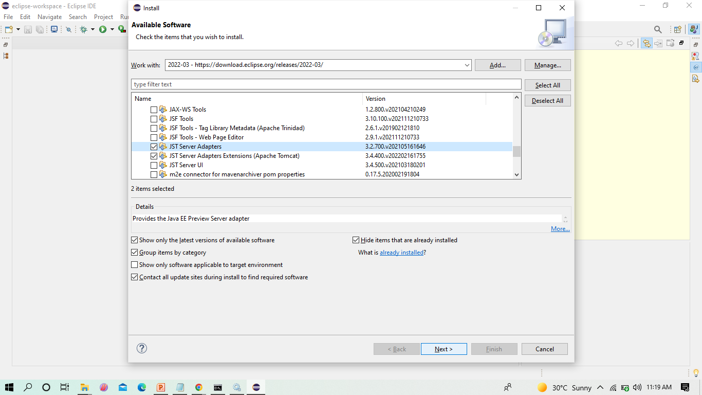
Here enable the JST Adapter and JST server adapter

Slide 23
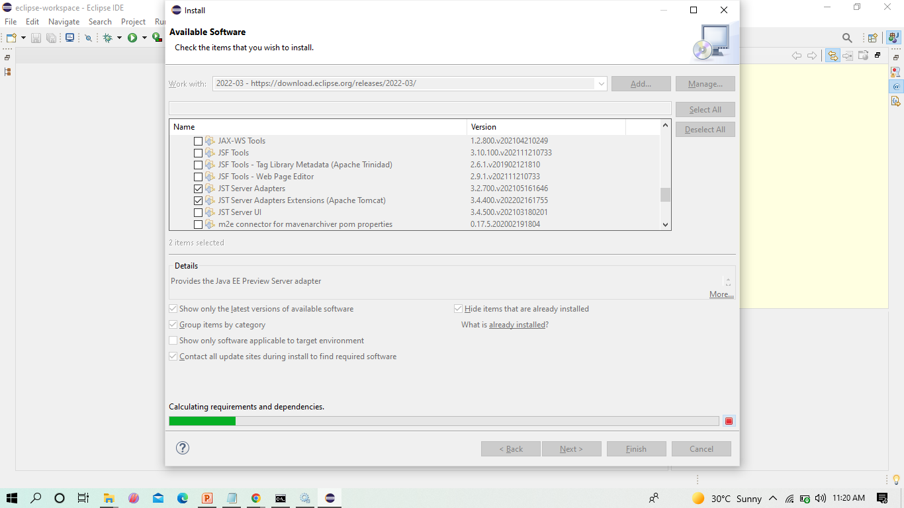
Install them

Slide 24
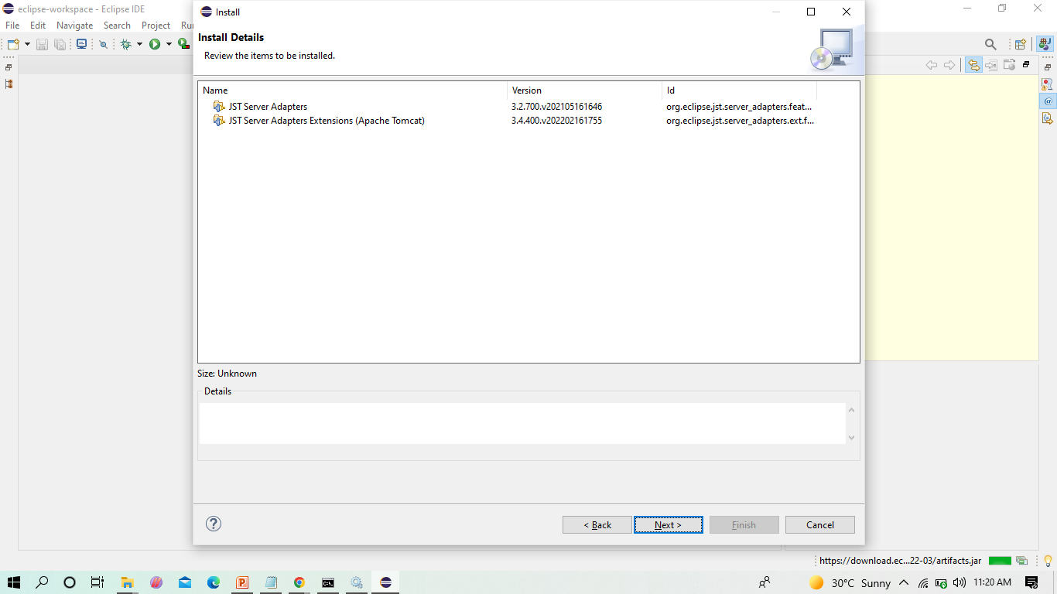
Click on -> Next

Slide 25
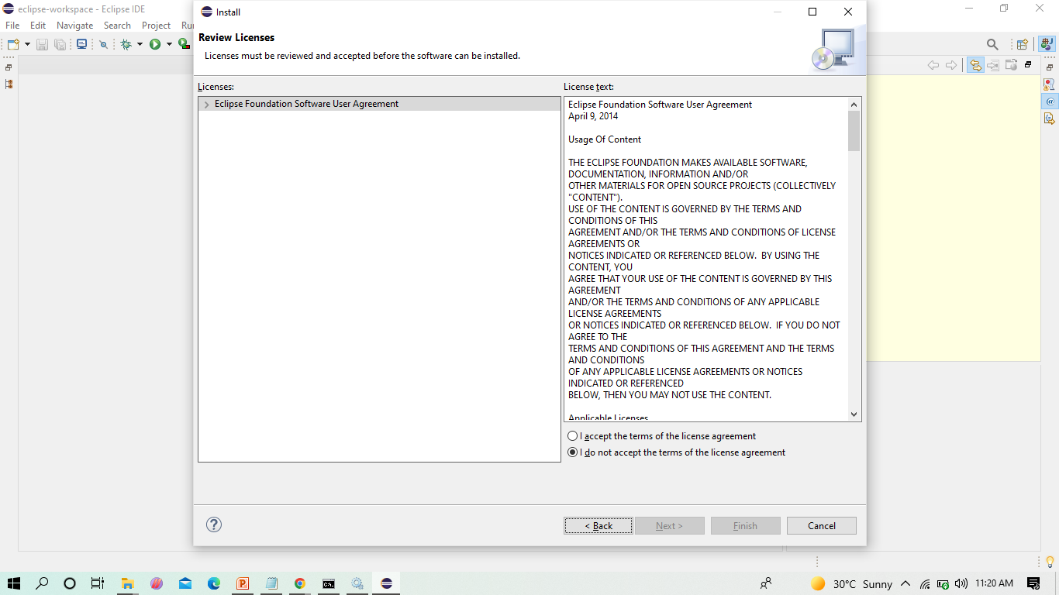
Select on -> I agree

Slide 26
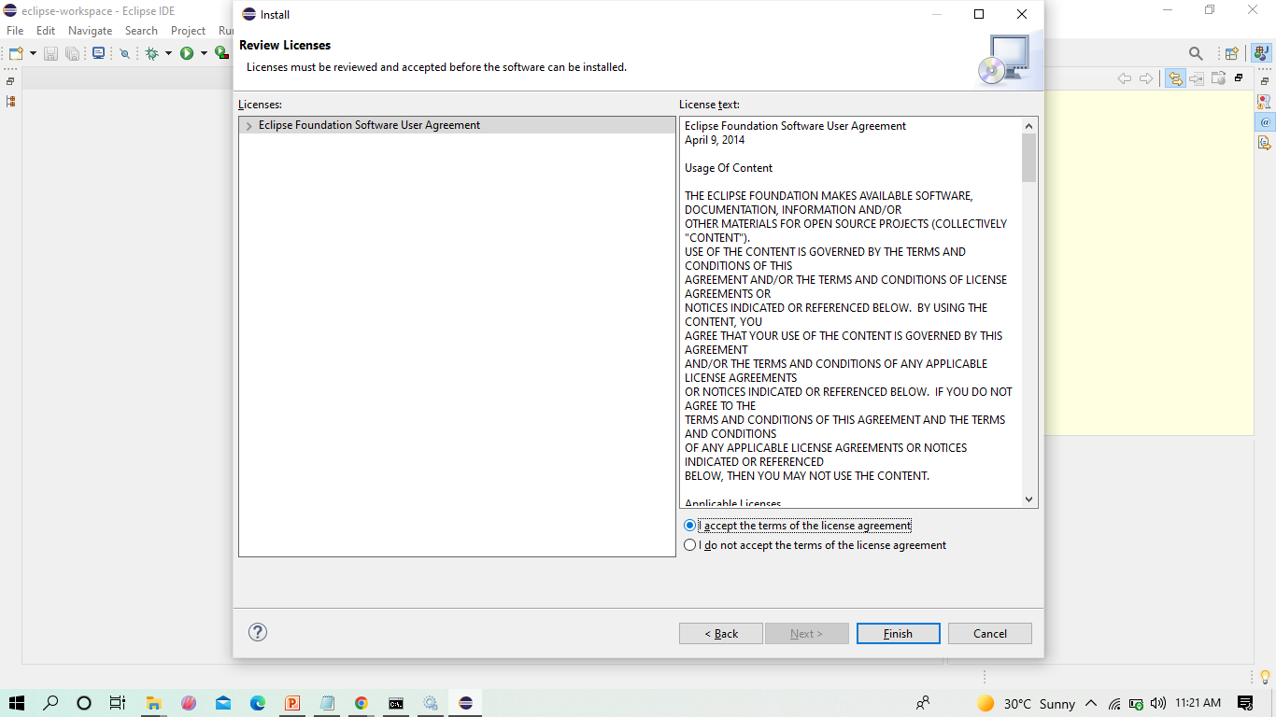
Select on -> I accept -> Finish

Slide 27
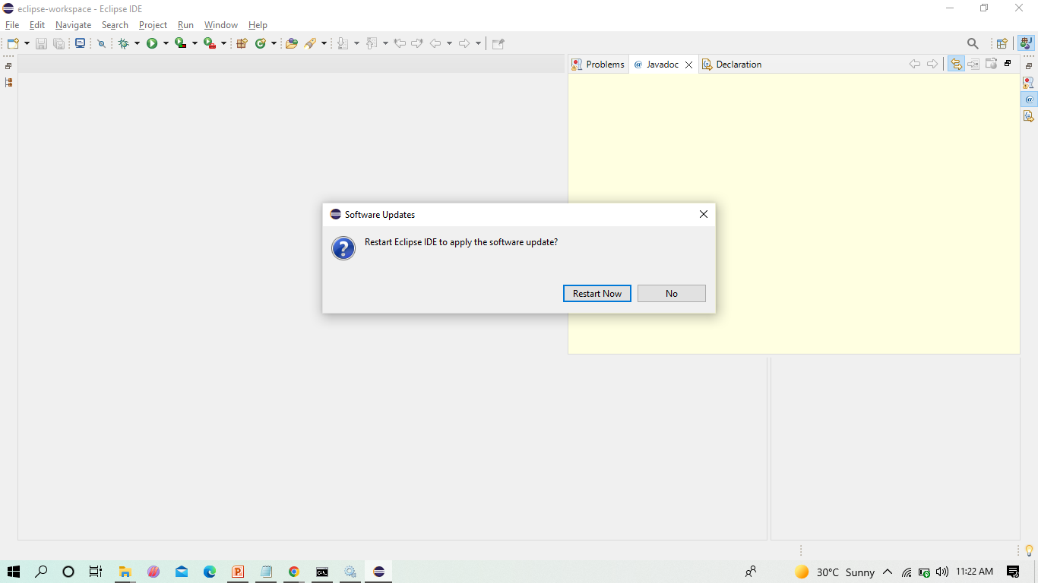
Restart the eclipse IDE

Slide 28
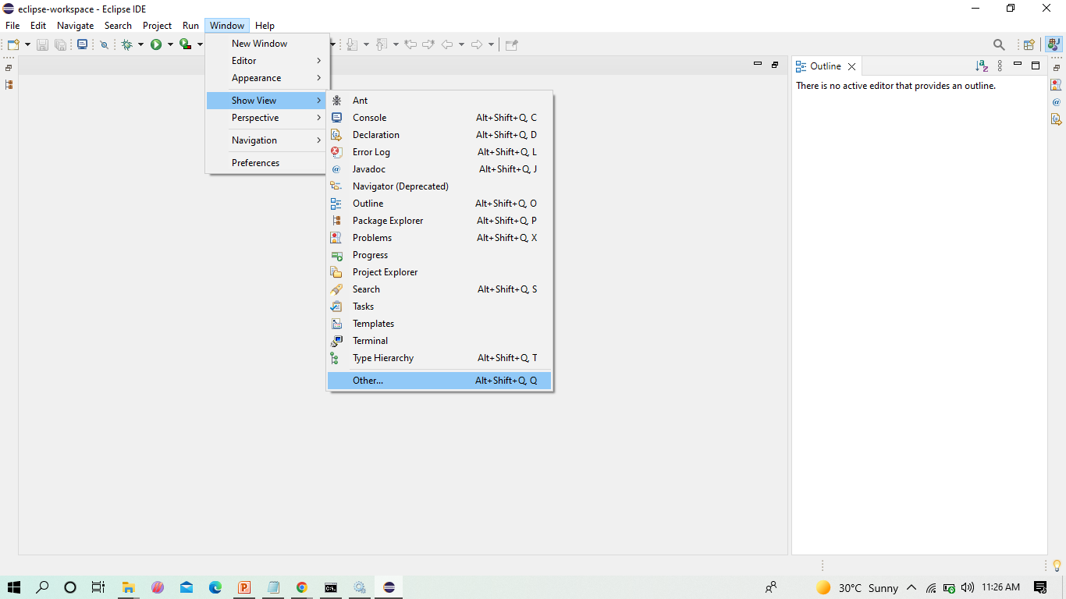
After the shown installation, check whether server is available in eclipse as shown

Slide 29
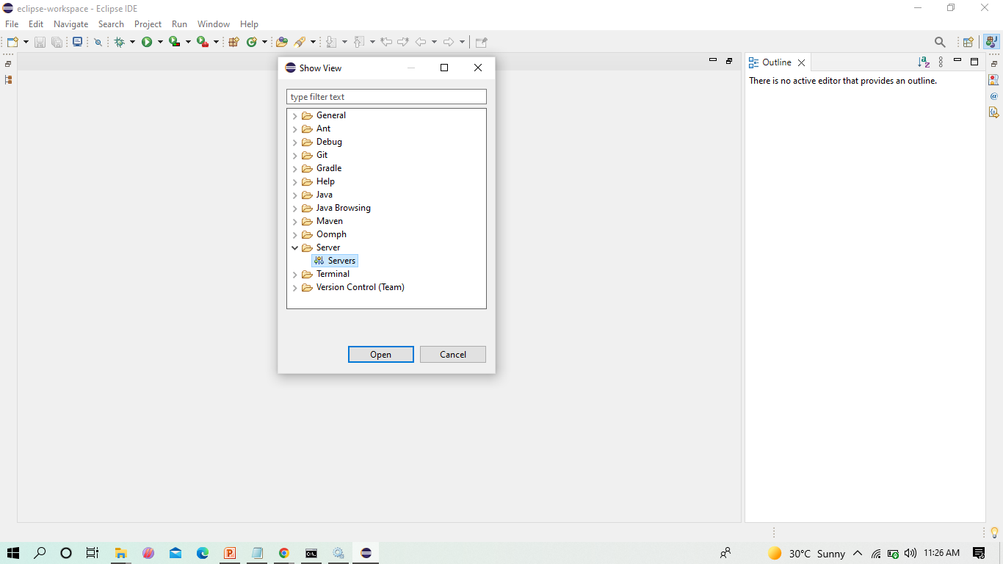
In Show View, we can now see Servers

Slide 30
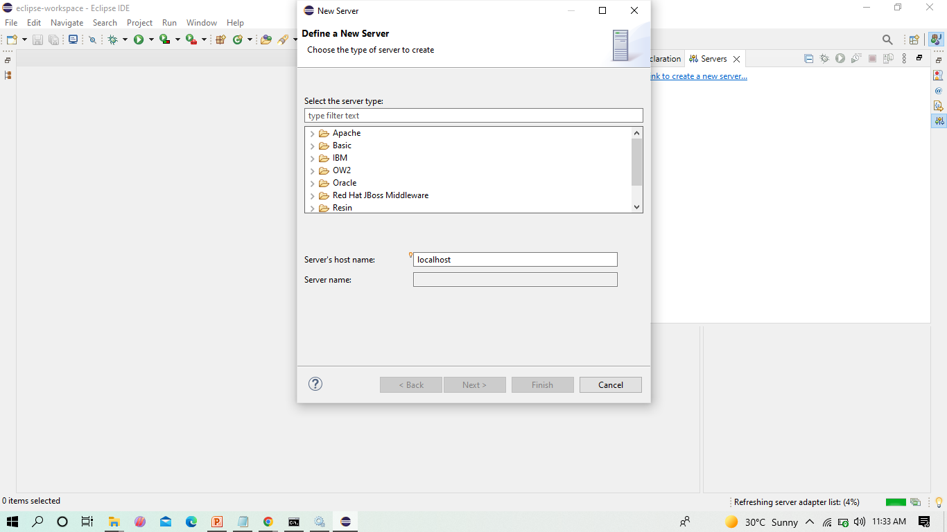
Click on Apache folder

Slide 31
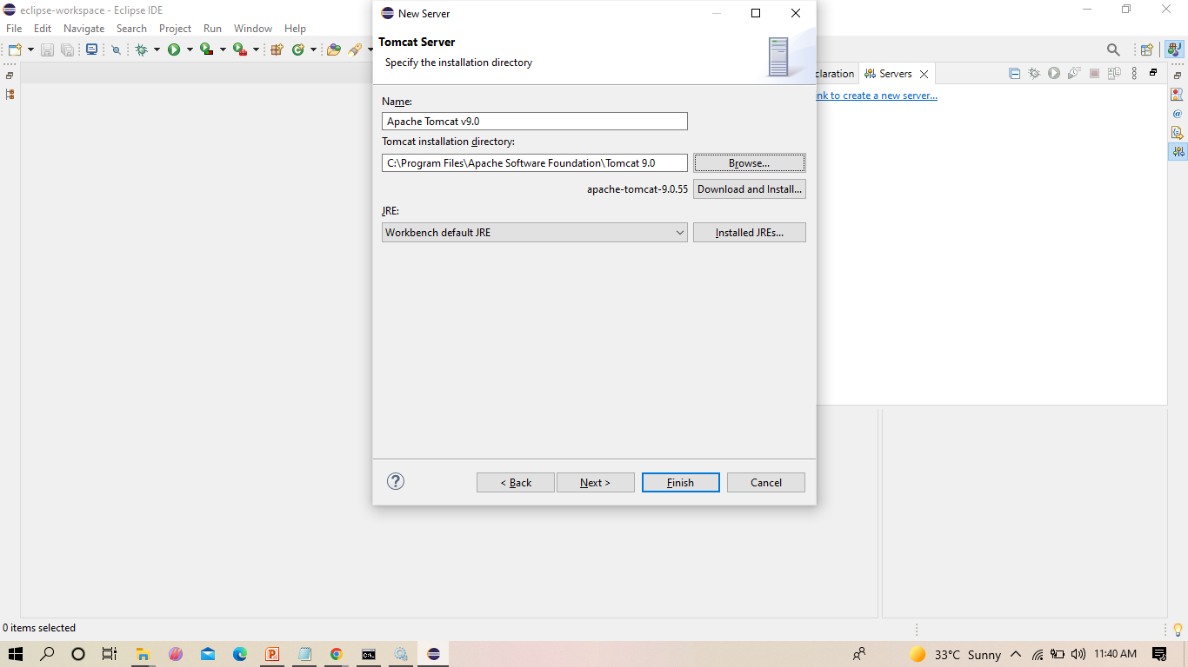
Browse the Tomcat folder available in your local system as shown

Slide 32
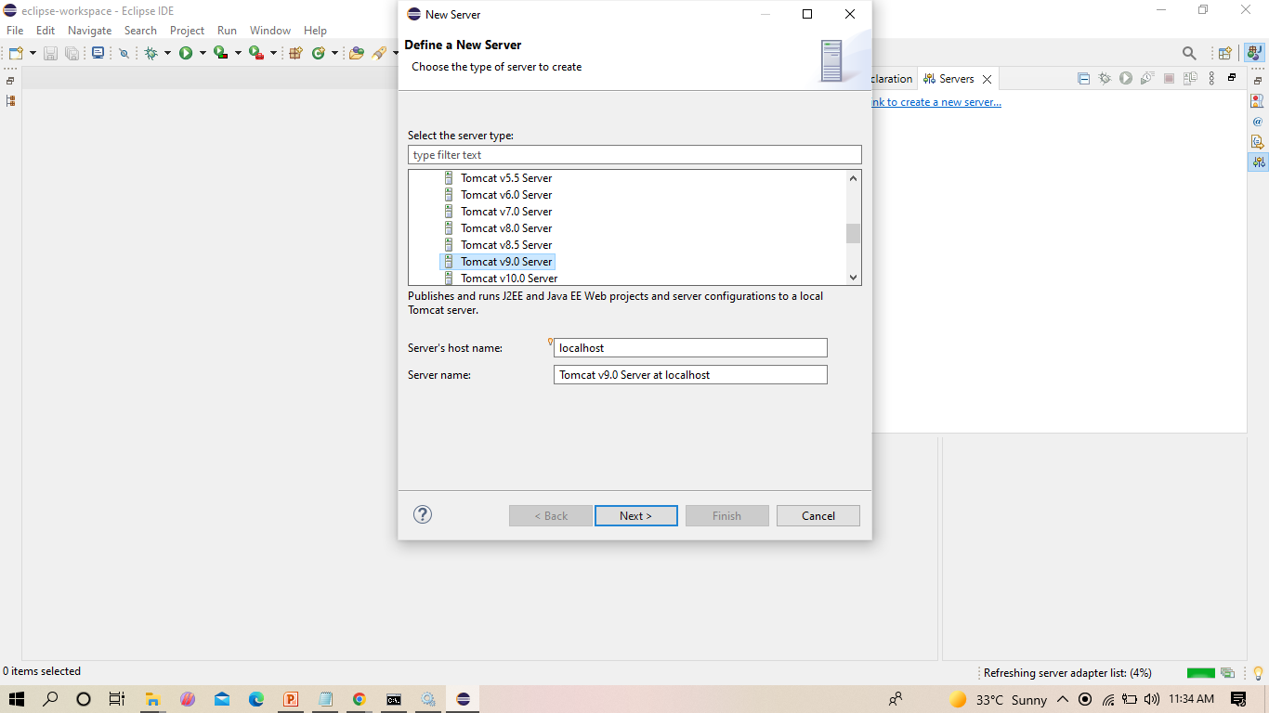
Select Tomcat V 9 as shown

Slide 33
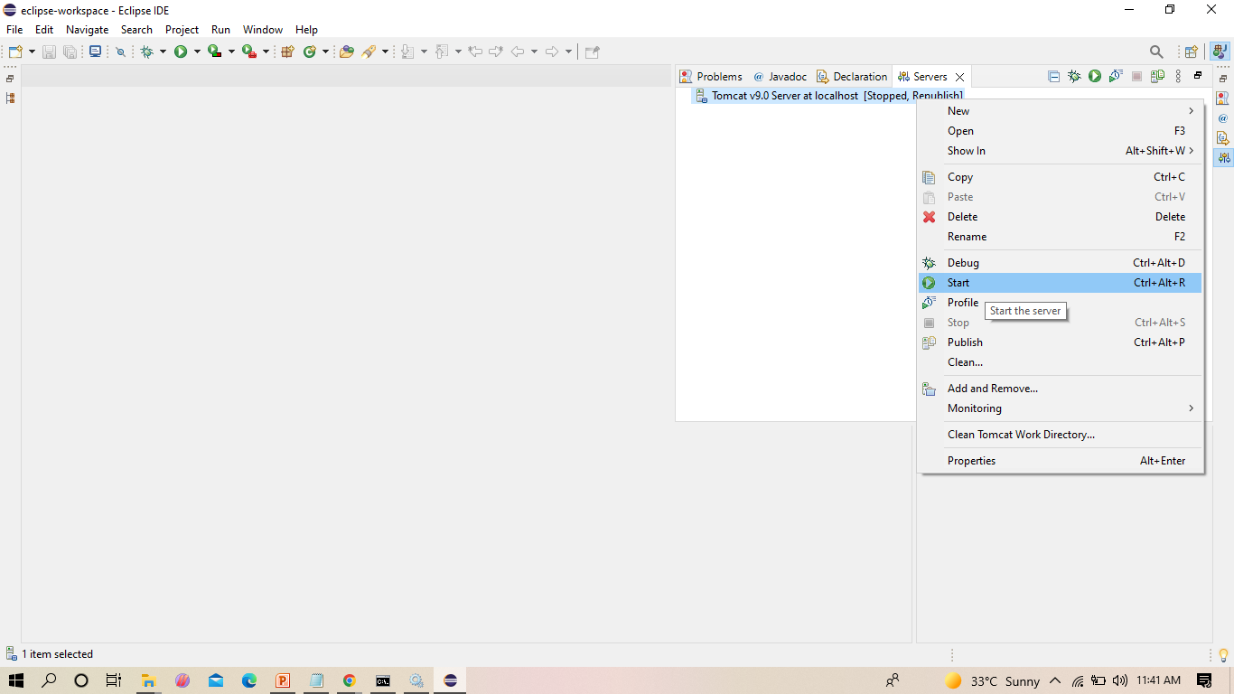
From now on we can start Tomcat server from Eclipse IDE as shown

Slide 34
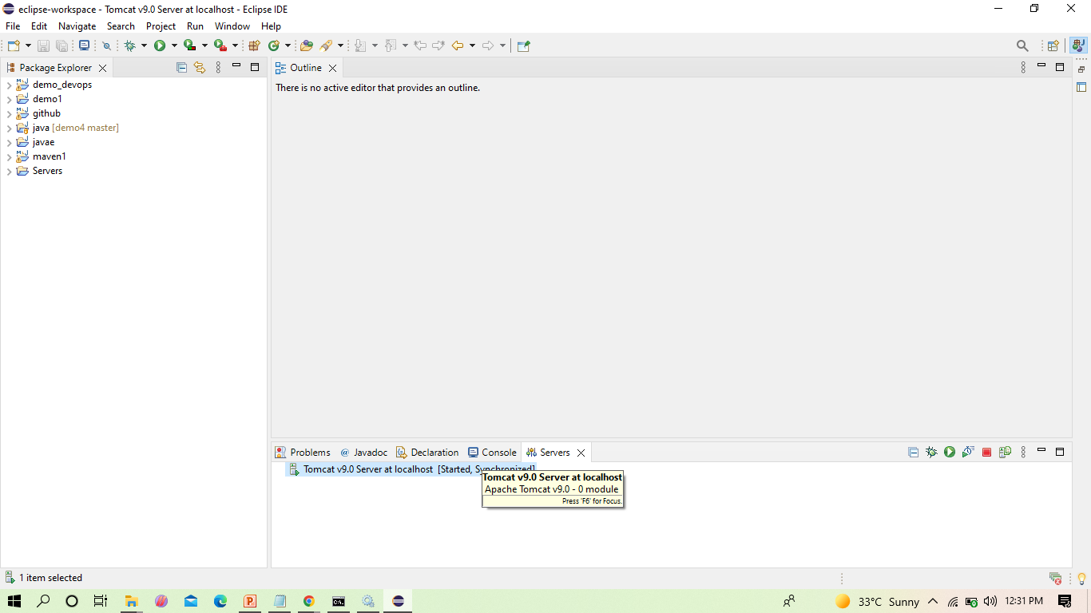
We can now see that the server is started
Double click on it

Slide 35
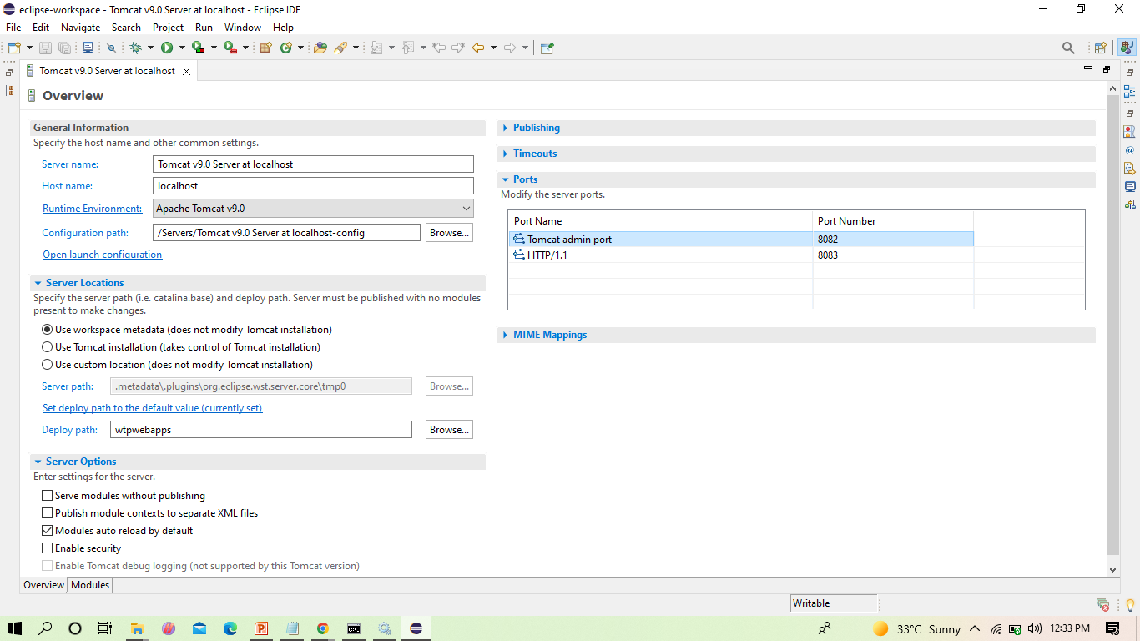
The next step is to change the port number of the Tomcat as Jenkins uses 8080, as shown

Slide 36
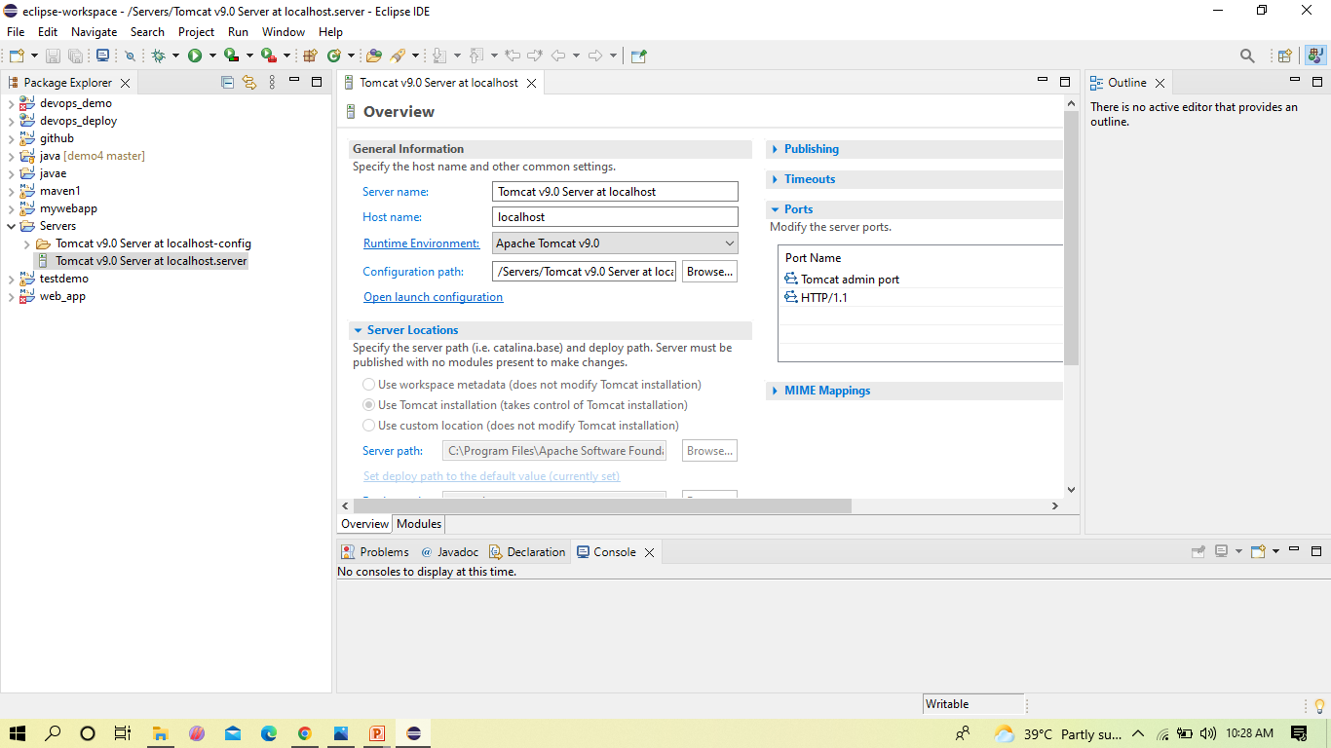
In server locations make sure second option is selected

Slide 37
Copy the following text in the location shown in the below slides
<role rolename="admin-gui,manager-gui ,manager-script,manager-jmx,manager-status"/>
<user username=“admin" password="1234"roles="manager-gui, admin-gui ,manager-script"/>

Slide 38
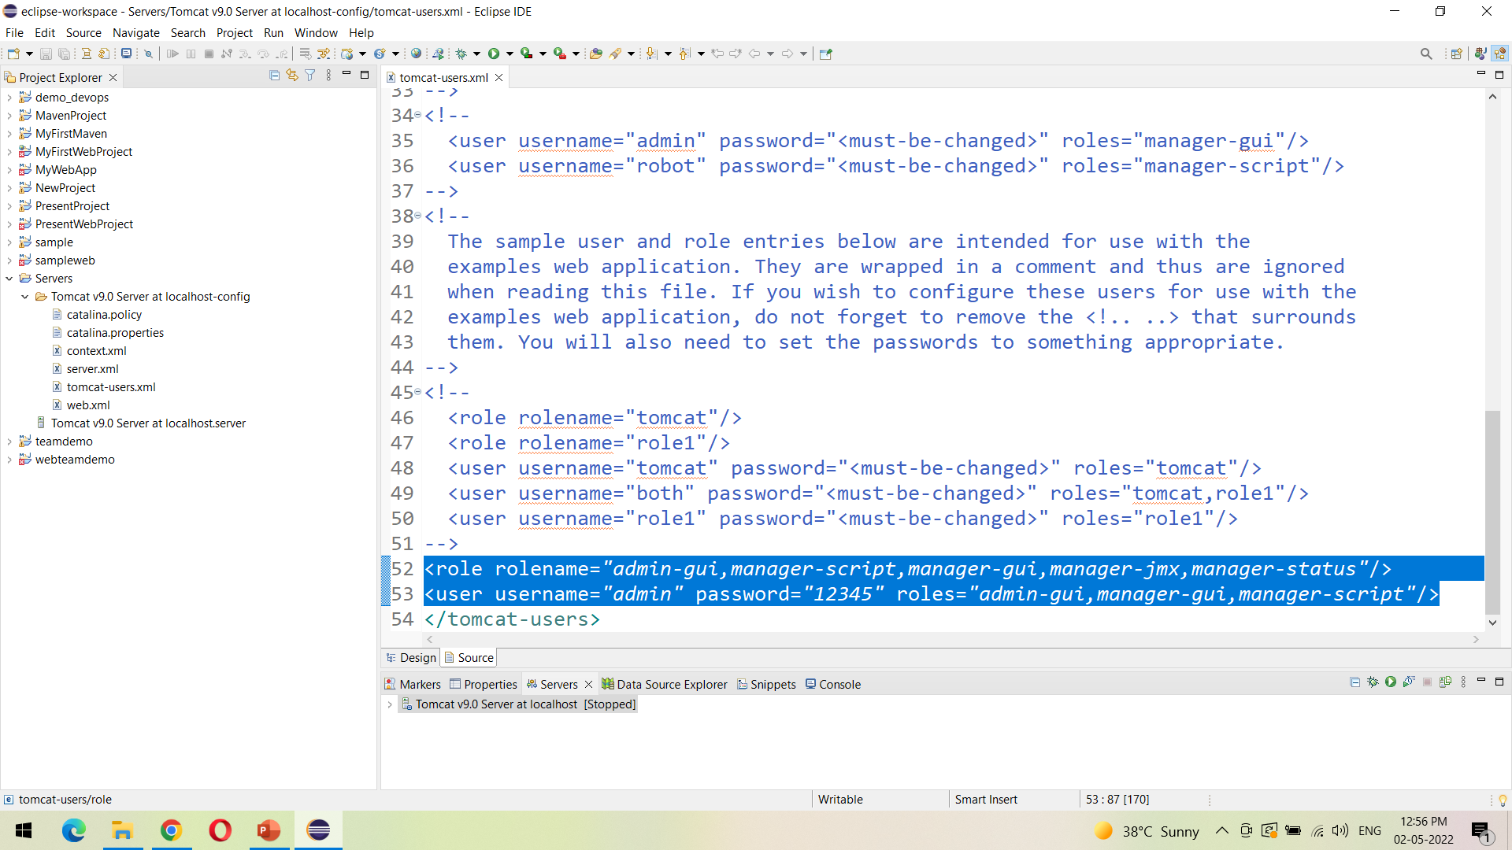
Open the tomcat-users.xml file as show, and add the highlighted text in the last

Slide 39
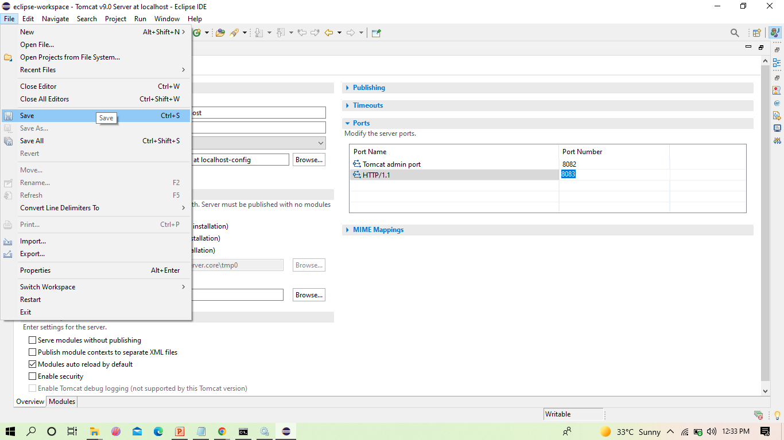
After the changes, click on save

Slide 40
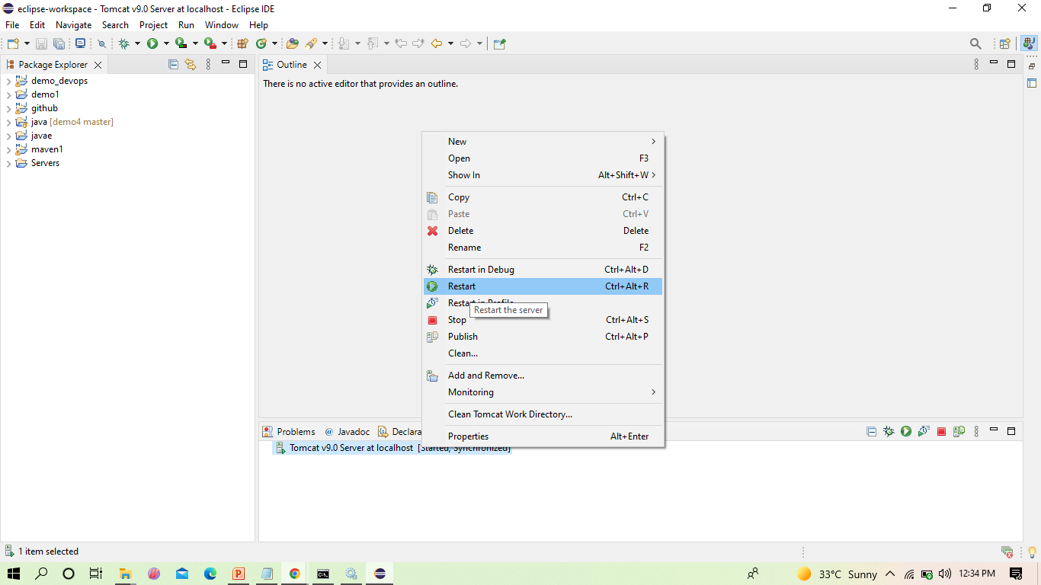
Now restart the server

Slide 41
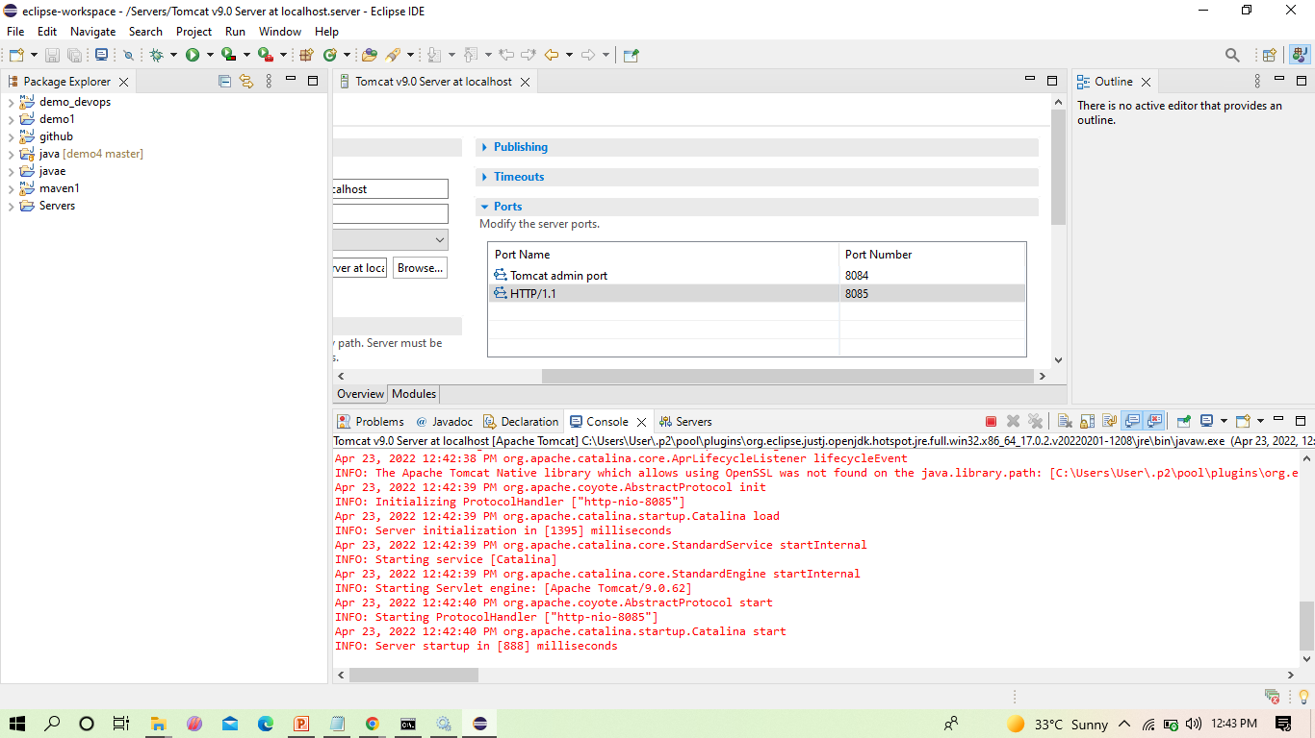
The server gets restarted as shown

Slide 42
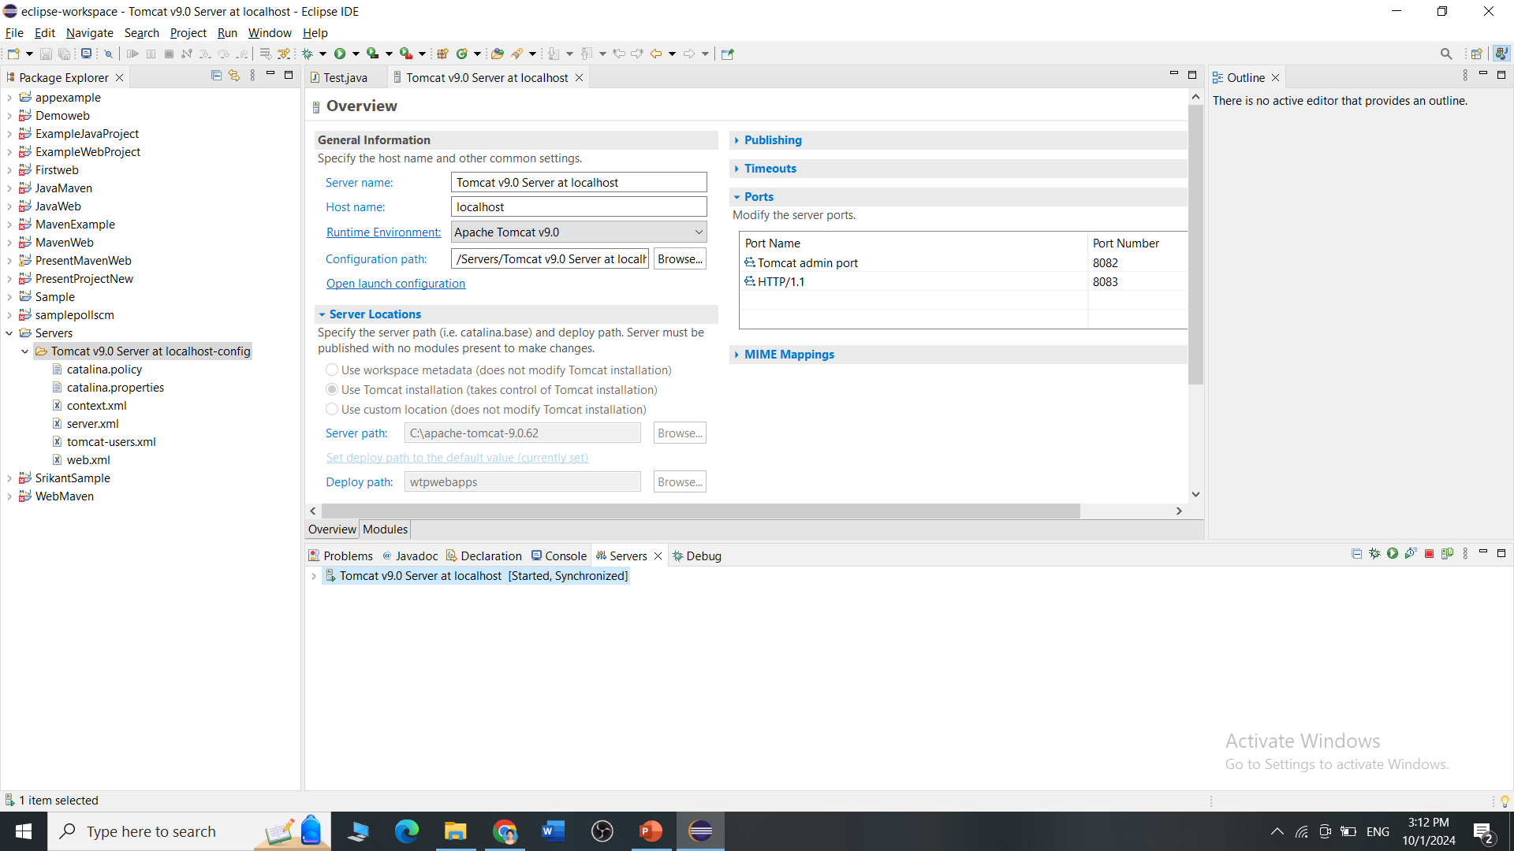
It should show server started

Slide 43
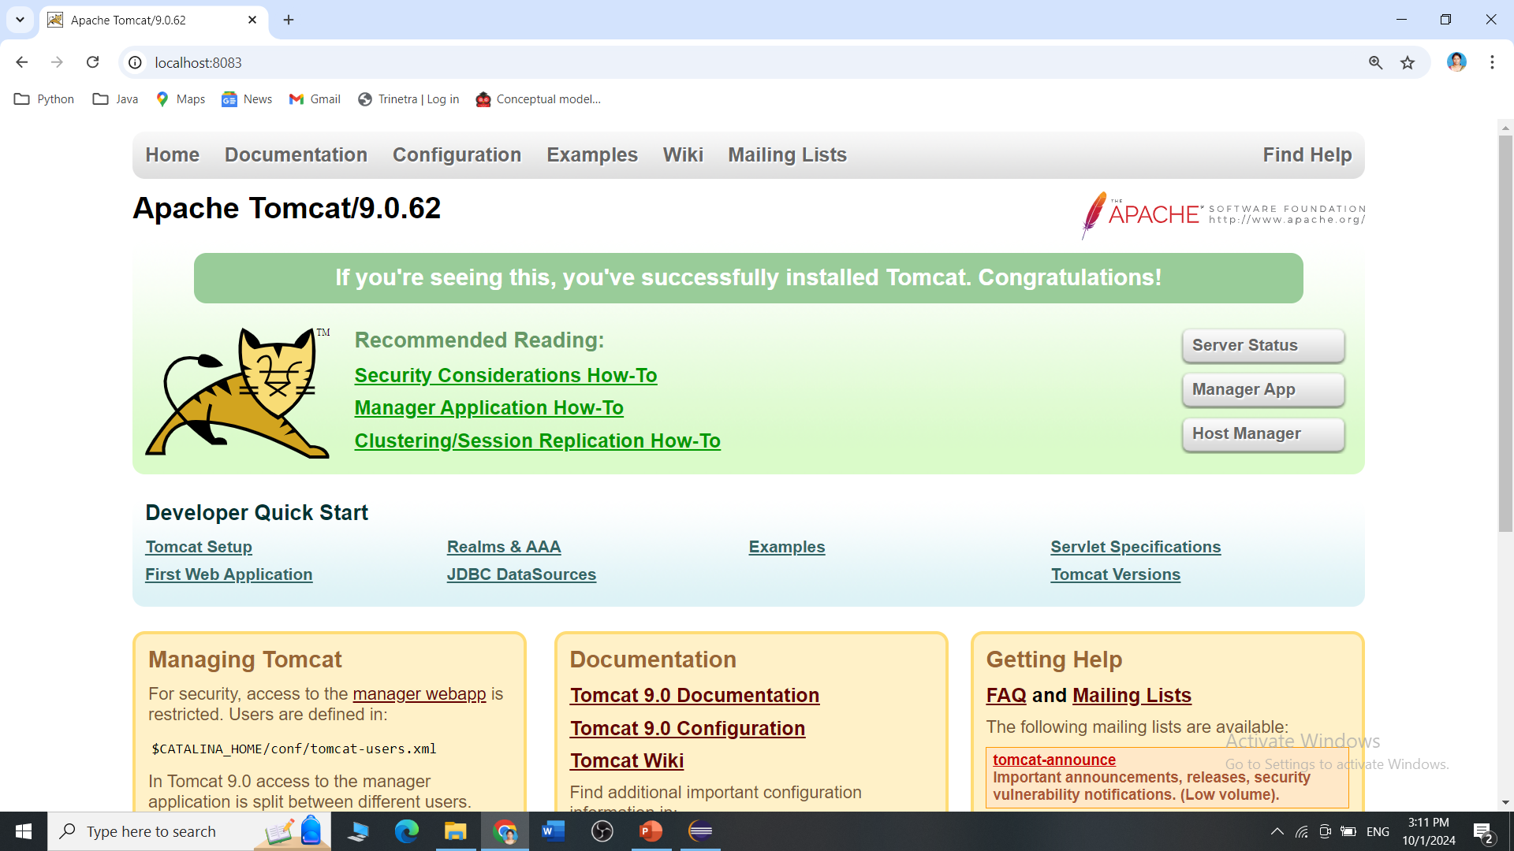
We can see the Tomcat is successfully running on the new port number

